Slide 1

COMP90050
Advanced Database Systems
Winter Semester, 2023
Lecturer: Farhana Choudhury (PhD)
Week 2 part 1

Slide 2
Core Concepts of Database management system
Efficiency
- Disks and I/O bandwidth
- Main memory
- Type of architecture
Database performance metrics
Hardware
Software/ DB tuning
- Types of DB
- Indexing
- Query optimisation
Efficiency/speed
Effectiveness
Effectiveness
Concurrent users
Security & Reliability
Transactions
Reliability
Crash recovery
Hardware:
Arrangement of multiple disks
Voting among multiple disks/modules
Disk block write
Fault tolerance
Data duplication

Slide 3
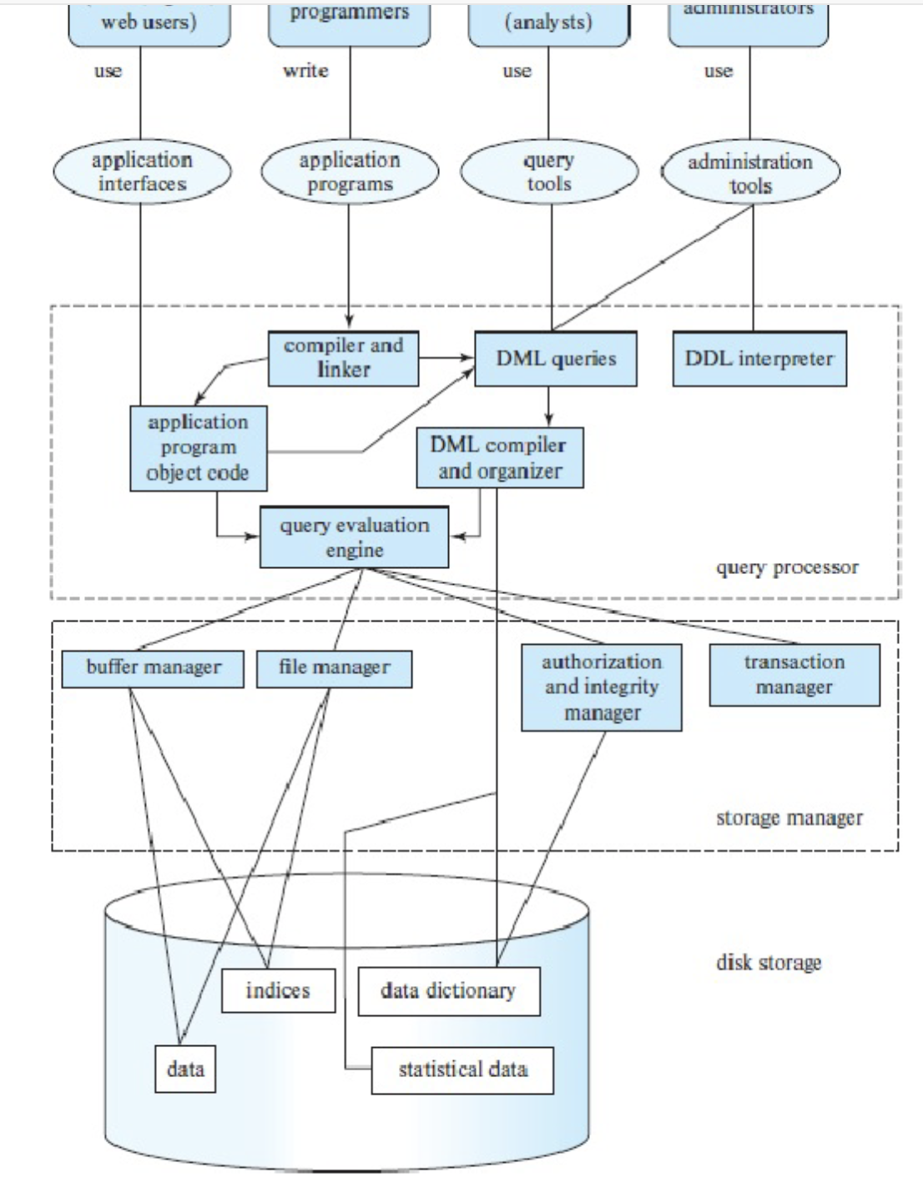
Database Engine
Notes:
Query optimization – we will look. Buffer and file manager – yes. Storage manager and transaction – concurrency control. Multiple people accessing, fig 1.3. chap 1.6

Slide 4
Different types of queries from
different types of users
Query evaluation engine
The storage manager provides the interface between the low-level data stored in the database and the application programs and queries submitted to the system.
The storage manager implements several data structures as part of the physical system implementation: (a) data files (the database itself); (b) Indices (to provide fast access to data items; (c) data dictionary (metadata)
Notes:
Query optimization – we will look. Buffer and file manager – yes. Storage manager and transaction – concurrency control. Multiple people accessing, fig 1.3. chap 1.6

Slide 5
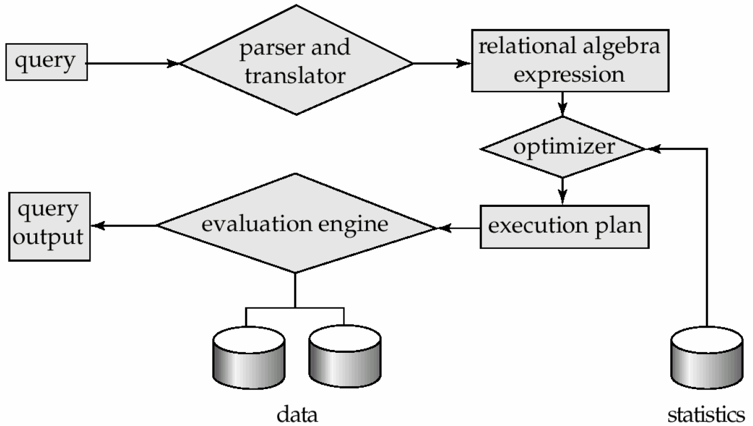
Query Processing Steps

Slide 6
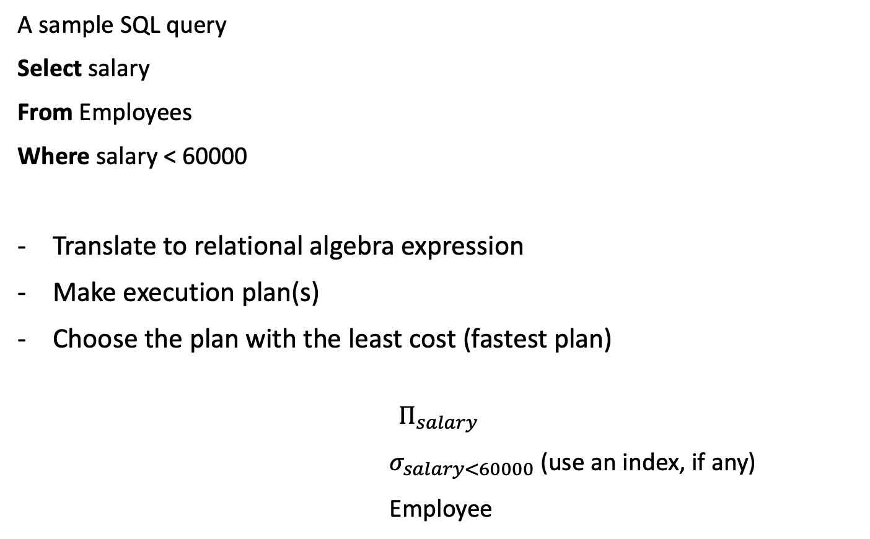
Query Processing
A sample SQL query
Select salary
From Employees
Where salary < 60000
Translate to relational algebra expression
Make execution plan(s)
Choose the plan with the least cost (fastest plan)
$$Π_{salary}$$
$σ_{salary<60000}$ (use an index, if any)
Employee

Slide 7
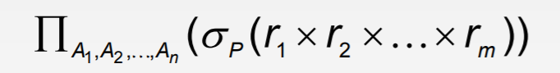
Recall: relational algebra expressions
Is same as the following in relational algebra expression:
Select A1, A2, …, An
From r1, r2, …, rn
Where P
Select salary
From Employees
Where salary < 60000
$Π_{salary}$($σ_{salary<60000}$ (Employees))
Can also be written as:
$σ_{salary<60000}$ ($Π_{salary}$(Employees))

Slide 8
Recall: join operations
…. Is same as the following in relational algebra expression:
Select *
From r1
Inner Join r2
on T1.a = T2.b
SELECT salary
FROM Employees
INNER JOIN Managers
ON Employees.EmpID = Managers.EmpID;
$Π_{salary}$($σ_{Employees.EMPID=Managers.EMPID}$ (Employees X Managers))

Slide 9
More on Joins
r _{θ} s r s
Here, r and s are tables
Theta (θ) is the condition (for example, <,>,=)
Natural join – joining based on common columns
Joins are very common and also very expensive
Natural join
Notes:
Natural join can only be performed if there is a common attribute (column) between the relations. The name and type of the attribute must be same.

Slide 10

How data are stored
Files – A database is mapped into different files. A file is a sequence of records.
Data blocks – Each file is mapped into fixed length storage units, called data blocks (also called logical blocks, or pages)
Record/row

Slide 11
How data are stored
Files – A database is mapped into different files. A file is a sequence of records.
Data blocks – Each file is mapped into fixed length storage units, called data blocks (also called logical blocks, or pages)
Cost of a query – The number of pages/ disk blocks that are accessed from disk to answer the query
Most dominant cost
(Recall from memory hierarchy!

Slide 12


Query plans and optimisation
Steps in cost-based query optimisation
Generate logically equivalent expressions of the query
Annotate resultant expressions to get alternative query plans
Heap scan/Index scan?
What type of join algorithm?
$$σ_{Salary<60000}$$
$$σ_{Salary<60000}$$
Managers
Employees
Managers
Employees

Slide 13
Query plans and optimisation
Steps in cost-based query optimisation
Generate logically equivalent expressions of the query
Annotate resultant expressions to get alternative query plans
3. Choose the cheapest plan based on estimated cost
Estimation of plan cost based on:
- Statistical information about tables.
Example: number of distinct values for an attribute
Statistics estimation for intermediate results to compute cost
Cost formulae for algorithms, computed using statistics again
Heap scan/Index scan?
What type of join algorithm?

Slide 14

Estimation of query plan cost
Estimated cost to join
Estimated result size
Page oriented NLJ
$$σ_{Salary<60000}$$
Managers (Heap scan)
Estimated
Cost for
this part
Employees (index)

Slide 15

How to estimate costs
Step 1: Result size calculation using Reduction Factor
$$σ_{Salary<60000}$$
What can go wrong?
Employees
Depends on the type of the predicate:
Col = value: RF = 1/Number of unique values (Col)
Col > value: RF = (High(Col) – value) / (High(Col) – Low(Col))
Col < value: RF = (val – Low(Col)) / (High(Col) – Low(Col))
Col_A = Col_B (for joins):
RF = 1/ (Max number of unique values in Col_A,Col_B)

Slide 16



How to estimate costs
Step 2: Different options for retrieving data and calculating cost (again, estimation)
$$σ_{Salary<60000}$$
$$σ_{Salary<60000}$$
Employees (Heap scan)
Employees (Index scan)
$$σ_{Salary<60000}$$
What can go wrong?
Employees
Managers

Slide 17

Joins Continued
Several different algorithms to implement joins exist that the optimizer can look at and pick the best
  Nested-loop join
  Page-oriented nested-loop join
  Merge-join
  Hash-join
  …

Slide 18
Joins Contd.
There is a choice on how to run a query on the server
Choice is based on cost estimates:
  statistics,
  table sizes,
  available indices
  …
Decisions effect performance dramatically

Slide 19
A Simple Nested-Loop Join
To compute a theta join
for each tuple t_{r} in r do begin
for each tuple t_{s} in s do begin
test pair (t_{r},t_{s}) to see if they satisfy the join condition theta (θ)
if they do, add t_{r} • t_{s} to the result.
end
end

Slide 20
A Simple Nested-Loop Join Contd
r is called the outer relation and s the inner relation of the join.
Requires no indices and can be used with any kind of join condition.
Expensive since it examines every pair of tuples in the two relations.
Remember that for every retrieval, especially for a different item from the the disk in a nonconsecutive location we pay a seek time as a penalty, this is where it could happen a large number of times.
Could be cheap if you do it on two small tables where they fit to main memory though (disk brings the whole tables).

Slide 21
Let’s Calculate the Costs
Let’s see an example with the following bank database:
  Number of records of customer: 10,000 depositor: 5000
  Number of Pages of customer: 400 depositor: 100
In the worst case, if there is enough memory only to hold one page/block of each table, the estimated cost is
b_{r} + (n_{r} ∗ b_{s}) Page access

Slide 22
So Two Options Are
With depositor as the outer relation:
    100 + (5000 ∗ 400) = 2,000,100 page access,
With customer as the outer relation:
    400 + (10000 ∗ 100) = 1,000,400 page access
    If you had 1000,000 customers, then you would wait several hours for one simple join!

Slide 23
A Better Way:
Page-Oriented Nested-Loop Join
Variant of nested-loop join in which every page of inner relation is paired with every page of outer relation.
for each page B_{r} of r do begin
for each page B_{s} of s do begin
for each tuple t_{r} in B_{r} do begin
for each tuple t_{s} in B_{s} do begin
Check if (t_{r},t_{s}) satisfy the join condition
if they do, add t_{r} • t_{s} to the result.
end
end
end
end

Slide 24
Let’s Calculate the Costs
Let’s see an example with the following bank database:
  Number of records of customer: 10,000 depositor: 5000
  Number of Pages of customer: 400 depositor: 100
In the worst case, if there is enough memory only to hold one page/block of each table, the estimated cost is
b_{r} + (b_{r} ∗ b_{s}) Page access

Slide 25
So Two Options Are
With depositor as the outer relation:
    100 + (100 ∗ 400) = 40100 page access,
With customer as the outer relation:
    400 + (400 ∗ 100) = 40400 page access
    Several order or magnitude faster than NLJ!

Slide 26
Recap: Query plans and optimisation
Steps in cost-based query optimisation
Generate logically equivalent expressions of the query
Annotate resultant expressions to get alternative query plans
3. Choose the cheapest plan based on estimated cost
Heap scan/Index scan?
What type of join algorithm?

Slide 27
Why it’s important to have a good query optimiser?
It’s the heart of query efficiency
Generating all equivalent expressions exhaustively - very expensive
Must consider the interaction of evaluation techniques when choosing evaluation plans. Choosing the cheapest algorithm for each operation independently may not yield best overall cost
Estimations of the result size may not be accurate

Slide 28
So, In Real Life….
Cost-based optimization is expensive, thus….
- Systems may use heuristics to reduce the number of choices that must
be made in a cost-based fashion
- Heuristic optimization transforms the query-tree by using a set of rules
that typically (but not in all cases) improve execution performance:
  Perform selections early (reduces the number of tuples)
  Perform projections early (reduces the number of attributes)
  Perform most restrictive selection and join operations (i.e., with
smallest result size) before other similar operations

Slide 29
Real Life Contd
Some systems use only heuristics, others combine heuristics with cost-based optimization
Optimizers often use simple heuristics for very cheap queries, and perform exhaustive enumeration for more expensive queries

Slide 30
Real Life Contd
Some systems use only heuristics, others combine heuristics with cost-based optimization
Optimizers often use simple heuristics for very cheap queries, and perform exhaustive enumeration for more expensive queries

Slide 31
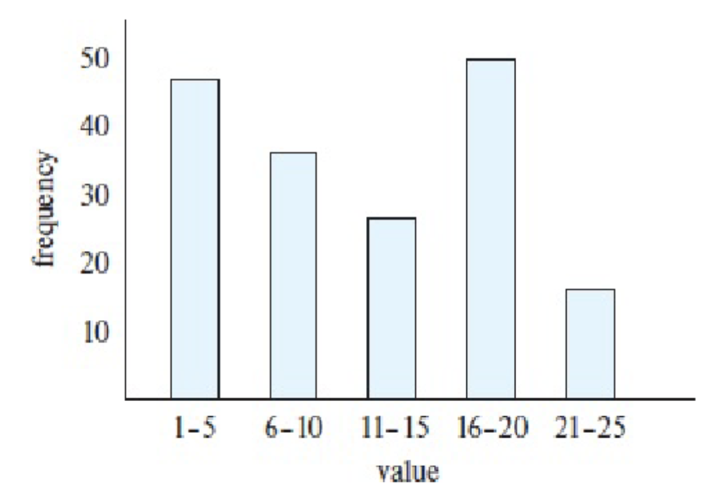
Further optimisation: Better estimation of reduction factors
Sampling
Histograms
Histogram width – learn from data
and query

Slide 32

Adaptive plans
Wait for one/some parts of a plan to execute first, then choose the next best alternative
Hash-join if >100 pages from Employees,
otherwise PNLJ (just as an example)
$$σ_{Salary<60000}$$
Managers
Employees

Slide 33
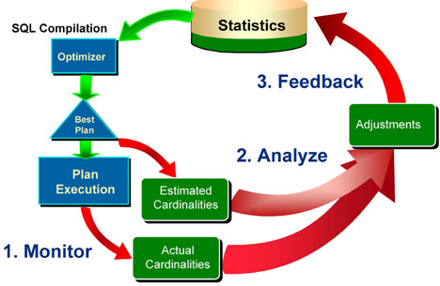
Readjust statistics: learning from mistake
Image courtesy: Allison Griffin

Slide 34
Summary
- Steps to find the cheapest plan
- Advanced optimisation

